Slide 1
Energy Model of EGFR Signaling Pathway
Zarifeh Heidari
June 9, 2022

Slide 2
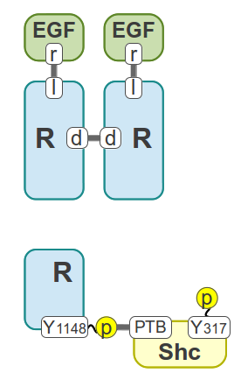
Step 1
Model Components:
EGF, EGFR, Shc

Slide 3
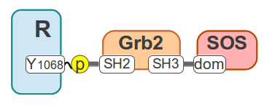
Step 2
Model Components:
EGF, EGFR, Shc, Grb2, SOS
Not considering the
connection Of
Shc and Grb2

Slide 4
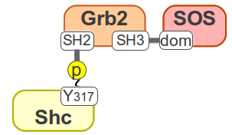
Step 3
Model Components:
EGF, EGFR, Shc, Grb2, SOS
considering the
connection Of
Shc and Grb2

Slide 5
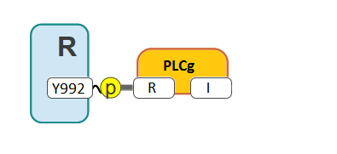
Step 4
Model Components:
EGF, EGFR, Shc, Grb2, SOS,
PLCg
Kholodenko Model
50 Parameters
Energy-Base Model
40 Parameters

